Slide 1
Optimal path tracking of a mobile robot
Constrained Numerical Optimization for Estimation and Control
Lorenzo Fagiano
M.Sc. Automation and Control Engineering, course 052358
Cataldo Giuseppe
Giacomelli Gianluca
Gottardini Andrea

Slide 2



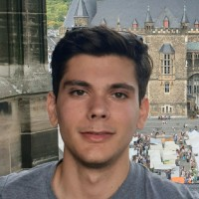
Who we are
Cataldo Giuseppe
Giacomelli Gianluca
Gottardini Andrea
Cataldo, Giacomelli, Gottardini
Cataldo, Giacomelli, Gottardini

Slide 3
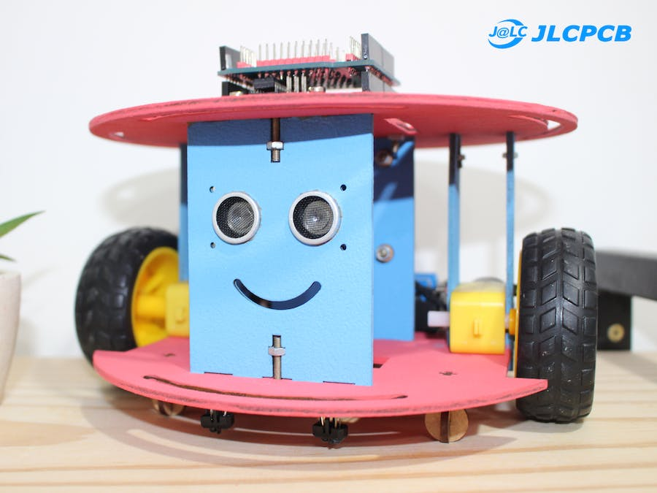
Our problem
Easy to integrate
Increased Flexibility
Increased Safety
Ability to Scale
Cataldo, Giacomelli, Gottardini
Unemployment
rate > 13%

Slide 4

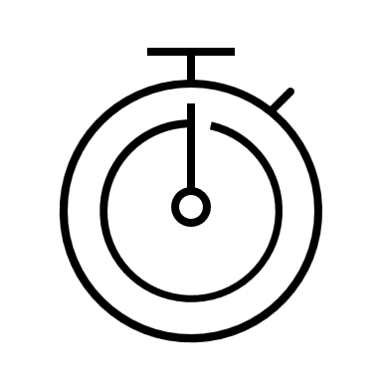



Our goal
MPC formulation
Cost function
Time
Counturing error
Energy consumption
Torque Right Wheel
Torque Left Wheel
States
Position
Yaw
Angular Rotation of wheels
Input
Angular Speed of wheels
Cataldo, Giacomelli, Gottardini

Slide 5
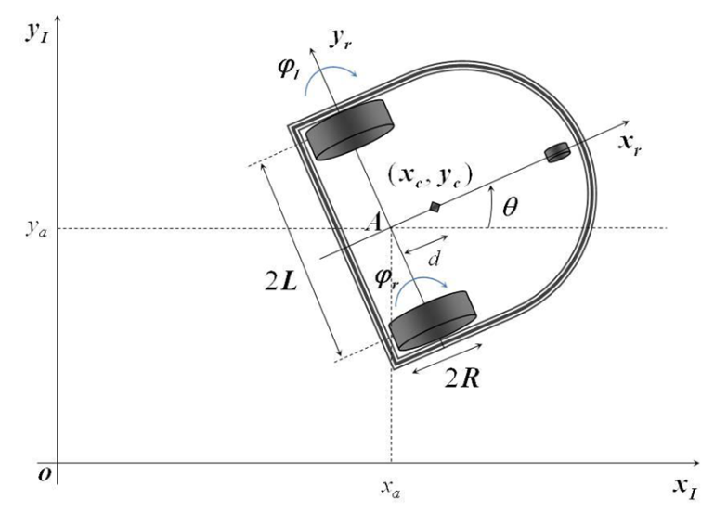

Model variables and parameters
$θ_{c}\left(t\right)$yaw angle
$x_{c}\left(t\right)$ x-coordinate of the center of mass
$Y_{c}(t)$ y-coordinate of the center of mass
$φ_{l}(t)$ angular rotation of the left wheel
$φ_{r}(t)$ angular rotation of the right wheel
$\dot{φ_{l}}(t)$ angular speed of the left wheel
$\dot{φ_{r}}(t)$ angular speed of the right wheel
$r(t)$ distance from a target point
2L width of the mobile robot
R radius of the wheel
I_{c.} moment of inertia of the car
I_{w.} moment of inertia of the wheel
d distance center of mass – rear axle
m_{w} mass of the wheel
m_{c} mass of the car
$\overline{τ_{r}}$ maximum right torque
$\overline{τ_{l}}$ maximum left torque
Variables
Parameters
Cataldo, Giacomelli, Gottardini

Slide 6
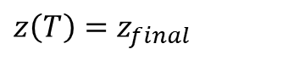
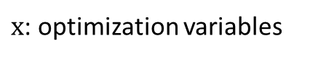



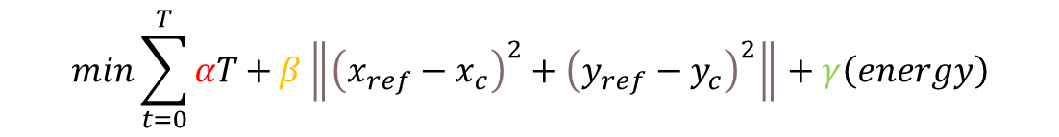
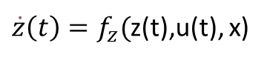
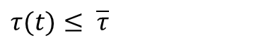
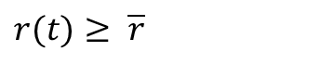

Cost Function and constraints
Time
Contouring error
Energy Consumption
Multi
optmization
problem
$$min\sum_{t=0}^{T}{αT+}β\left\|{\left(x_{ref}−x_{c}\right)}^{2}+{\left(y_{ref}−y_{c}\right)}^{2}\right\|+γ\left(energy\right)$$
$$x$$
$$S.T.$$
$\dot{z}\left(t\right)=f_{z}($z(t),u(t), x)
Model Equations
$$r(t)≥ \overline{r}$$
Distance from a target point
$$τ(t)≤ \overline{τ}$$
Maximum Torques
$$z\left(0\right)=z_{0}$$
Initial State
$$z\left(T\right)=z_{final}$$
Final State
$x$: optimization variables
$$x=\left[\begin{matrix}τ_{r} \\ τ_{l}\end{matrix}\right]$$
Cataldo, Giacomelli, Gottardini

Slide 7
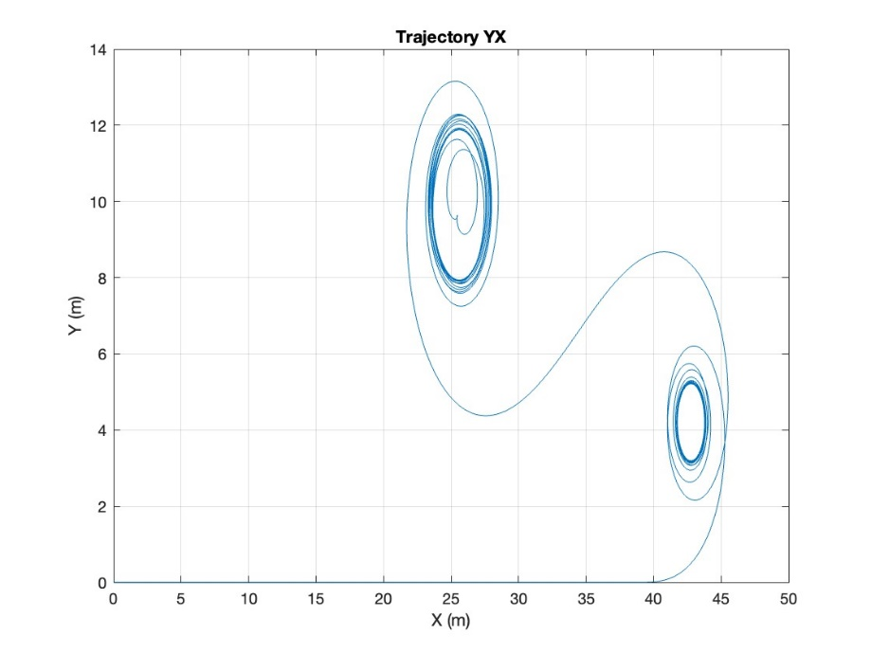
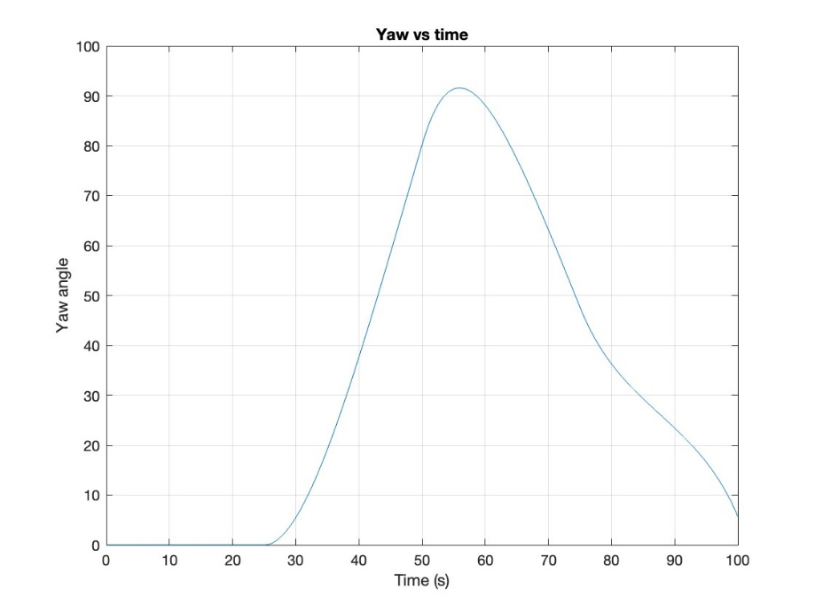
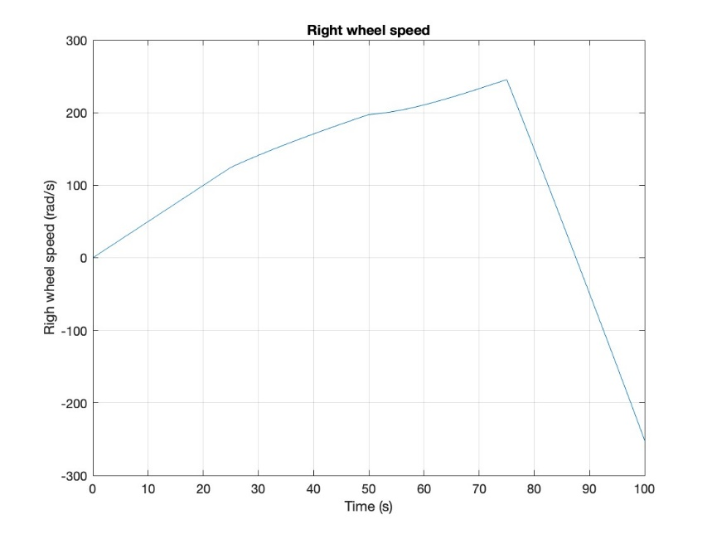
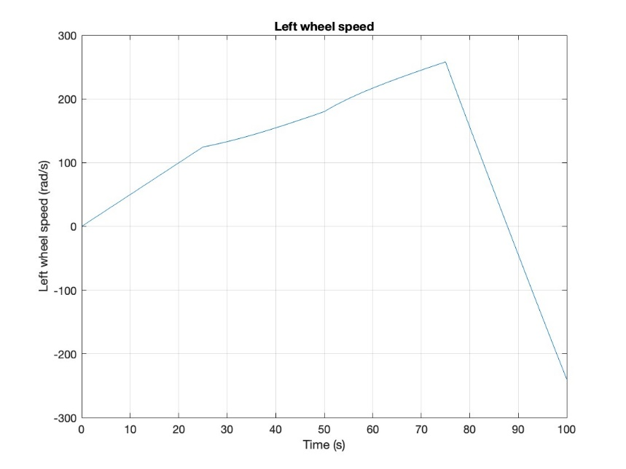
MATLAB Simulation Results
Trajectory
Yaw
DX wheel speed
SX wheel speed
Cataldo, Giacomelli, Gottardini

Slide 8
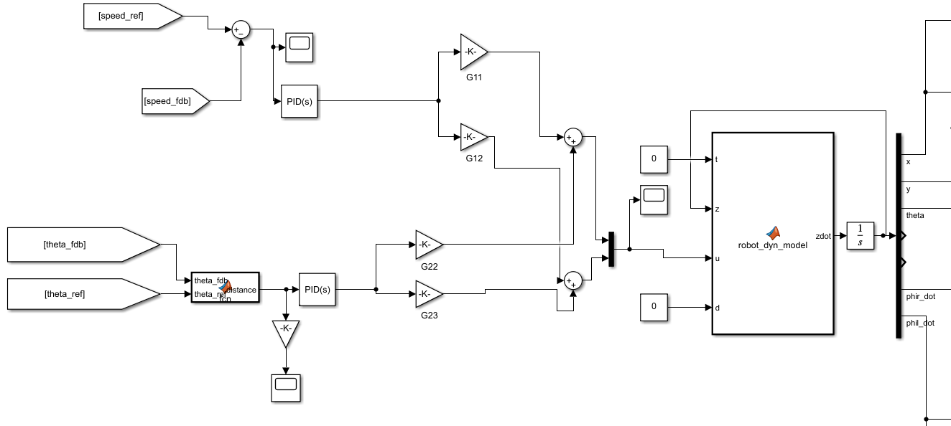
Simulink Model
Speed Reg
Speed Reg
Yaw Reg
Cataldo, Giacomelli, Gottardini

Slide 9
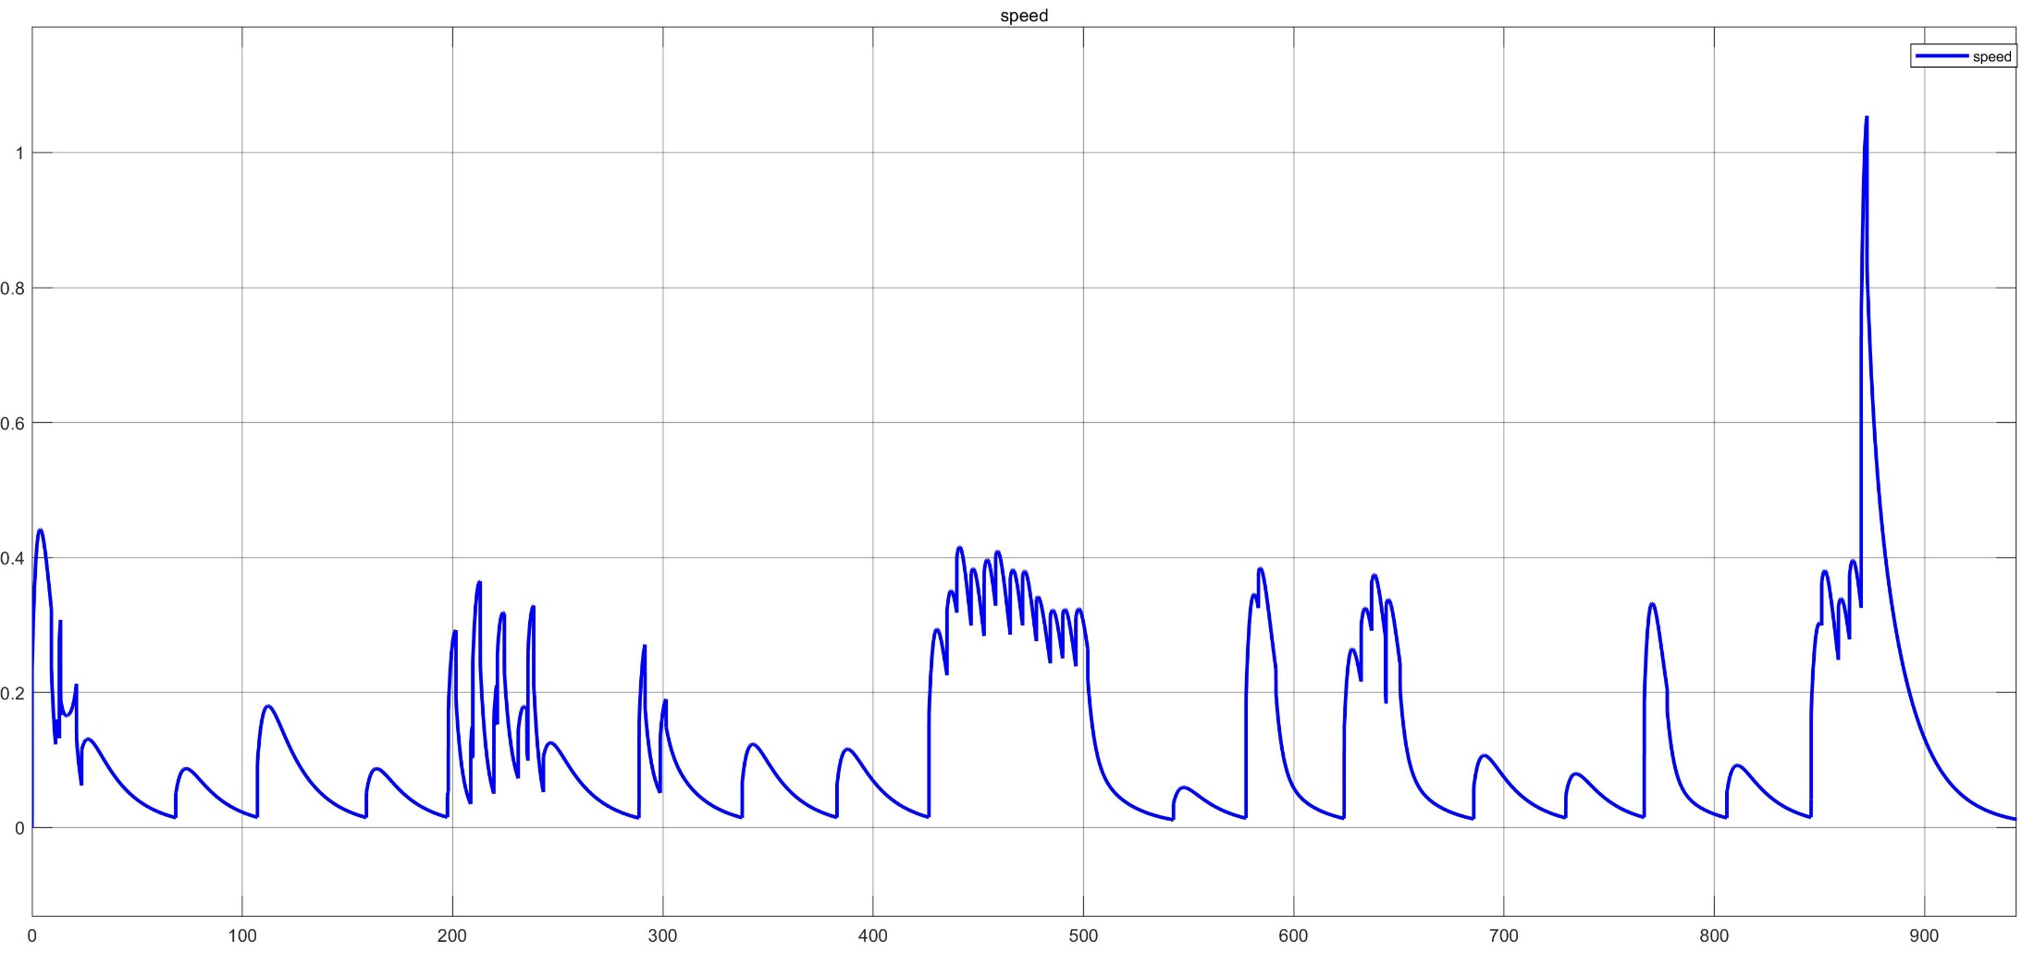
Speed Profile
A lot of wasted energy!
Cataldo, Giacomelli, Gottardini

Slide 10
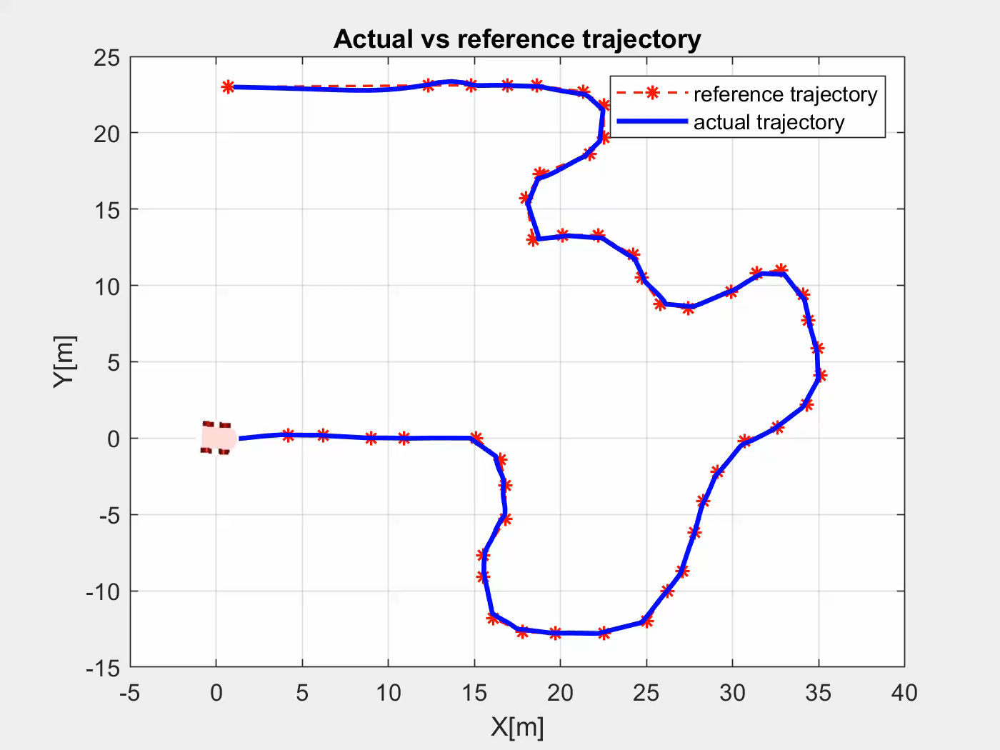
Path Following with PID regulators
Cataldo, Giacomelli, Gottardini

